Slide 1
User Interface Design

Slide 2
UI Design: Monday Aug 29 (Day 4)
Dr. Jillian Aurisano
Plan for today:
Reminders, course logistics
Review last week
Let’s think about the user’s goals, tasks, and concept of the system
Activity about the first project
Notes:
So welcome to engineering visual interfaces for data science. I'm Dr Aurisano.
Thanks for finding the class on Zoom. Hopefully we will be in person again soon.
If anyone out there is comfortable turning on their cameras, that is lovely- then I feel like I am talking to students, rather than to myself.
Here’s our plan for today:
First I’m going to introduce myself, so you know a bit about me
Then we are going to get to know each other, in Zoom breakout rooms. This will give us a chance to make sure that Zoom breakout rooms work, and we all know how to access them.
Then, I am going to walk through the structure, and plan for the course. I want to make sure everyone knows how the course will work, and what to expect, and also a bit about why the course is designed this way.
Then I am going to introduce the class, and what the class is about. Since this is a new class, and one of just a few classes in human centered computing here at UC, I wanted to give an overview of the topic.
Then I have an introductory activity, which we will do in breakout rooms, and which I think will help motivate the discussion on Wednesday, and getting into the meat of the class.

Slide 3
Course logistics
Homework:
Still open- turn it in!
Syllabus:
Questions?
This week:
Building our 1st project requirements together
Bring a sketchbook or sketching device
Next week:
Let’s get technical- html, css, javascript

Slide 4
Let’s start with learnability
https://www.youtube.com/watch?v=pQHX-SjgQvQ&list=PPSV
Why is this funny?
Is it hard to learn to use a physical book?
Let’s bracket this and we can return to it…
Let’s think about digital interfaces and how we learn to use it

Slide 5
How do you learn to use a new interface?
Any thoughts- think about something you learned to use recently…

Slide 6
How do you learn to use a new interface?
Any thoughts- think about something you learned to use recently…
2 approaches:
Learn to use by just trying to accomplish your task
Learn to use by reading a manual/how-to or watching tutorial video

Slide 7
How do you learn to use a new interface?
Any thoughts- think about something you learned to use recently…
2 approaches:
Learn to use by just trying to accomplish your task
Learn to use by reading a manual/how-to or watching tutorial video
When are these 2 approaches used?

Slide 8
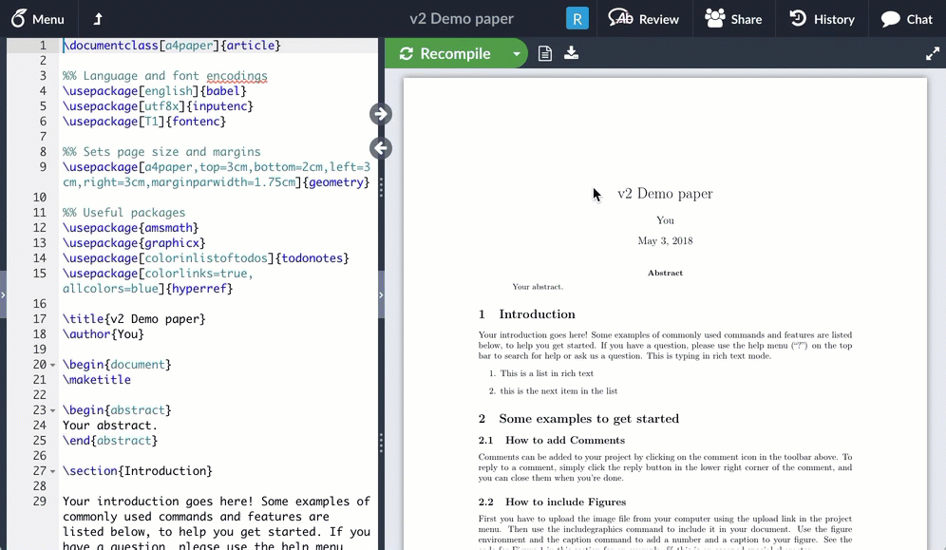
Learning approaches

Slide 9
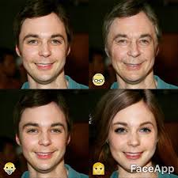
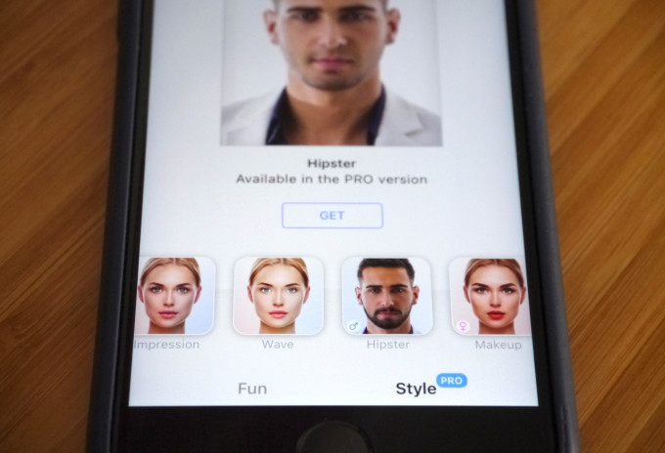
Learning approaches

Slide 10
In some cases, you will learn by reading a manual, watching a tutorial, taking a course
Complex tasks
Specialists/experts
Tasks you need to accomplish for work
But- ideally you try to design so people can learn by doing.

Slide 11
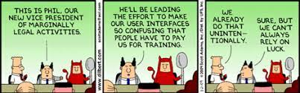
Not the goal….

Slide 12
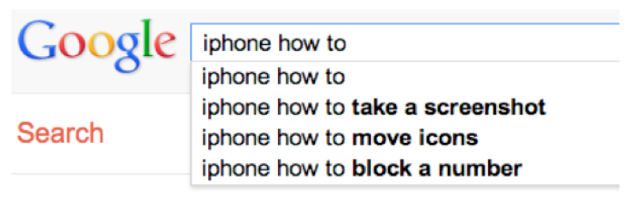
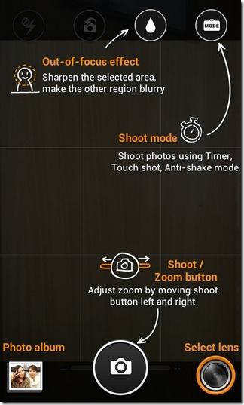
Learn by seeking help?
Users resort to seeking help when they get stuck
User already has a problem and are looking for concrete solutions
Last resort options:
Chatbots to help
Help buttons
Search
Giving these help options is good, but not enough
But- at least make the help searchable and goal-oriented
Ex- overlays

Slide 13
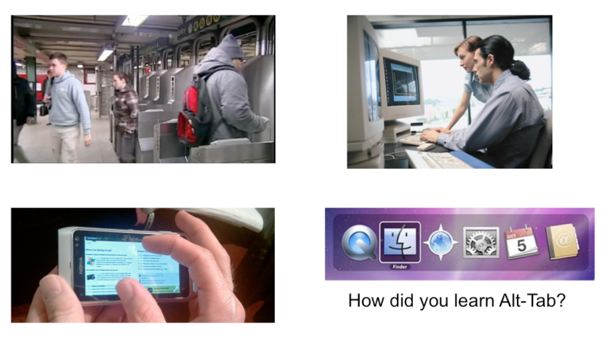
Learn by watching others?
You watch someone use something
(note- this is how I learned to use Sage)
But, can’t count on this….
Maybe professional software…

Slide 14
Most users learn by doing
Users don’t start using a system to learn it
User’s typically try to do what they want to do, they have a goal in mind
They explore the interface to see if they can figure out how to do it.
Users are more interested in achieving their goal than in learning your interface
As a UI designer your job is to clearly communicate how to use the UI, through the design, and help the user achieve their first goal
User expectation: getting things done, not learning the interface.

Slide 15
Lessons for UI Designers
We want to match the design to the user’s goals
So, we need to:
Know who the users are
Know the users’ goals when you design
Process for collecting this information -> user centered design process

Slide 16
But before we understand our users’ goals….

Slide 17
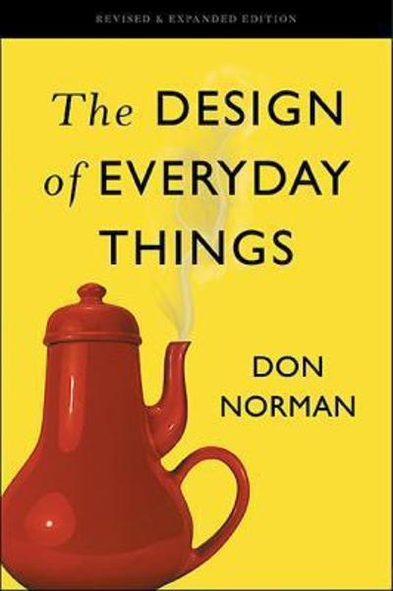
But before we understand our users’ goals….
Fundamental concepts about how people interact with things and discover what they do (Don Norman)
Affordances
Signifiers
Constraints
Mappings
Feedback
User’s conceptual model of the system

Slide 18
Affordance
Affordances are perceivable action possibilities
Affordance refers to the perceived and actual properties of a thing that determine how it is operated
Affordances are how an interface communicates non-verbally, telling you how to operate it

Slide 19
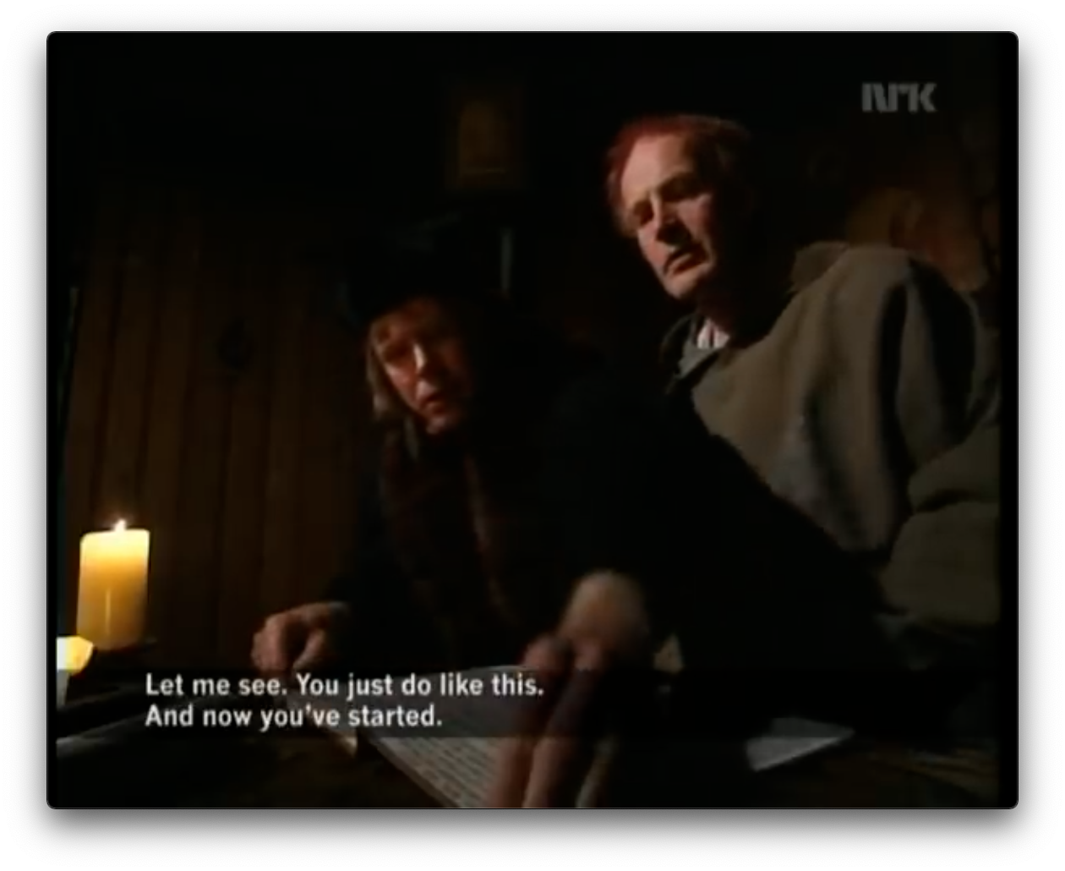
Returning to our joke about learning to use a book
Books have affordances
Pages are for flipping
Pages can be flipped forwards and backwards
Book covers can be opened, closed
It doesn’t need a sign, or a manual
It’s physical properties communicates these things

Slide 20
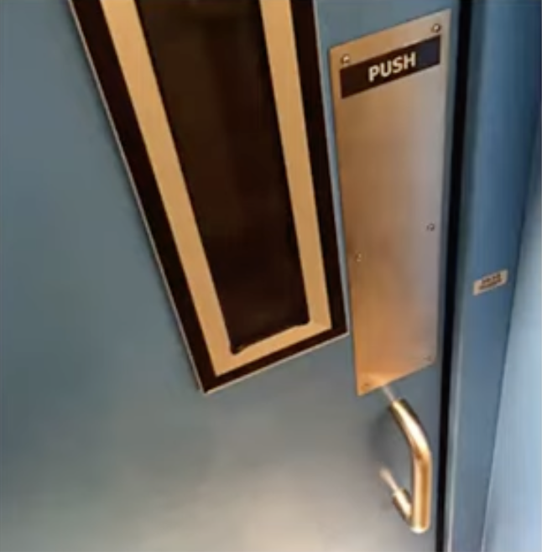
Returning to our door example
Doors have an affordance of being pushed or pulled open
Handles have an affordance of being grabbable and pullable
People will walk up to this ‘push’ door and try to pull it open

Slide 21
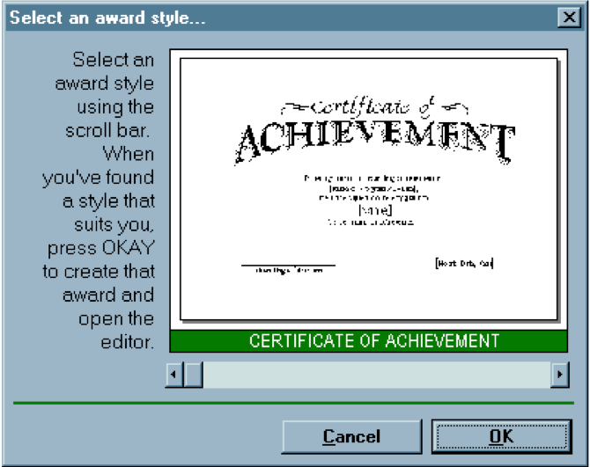
Returning to our interface hall of shame example
Scrollbars have a property (affordance) of being continuously draggable for continuous scrolling – smooth movement left/right
Not for discrete selection

Slide 22
Perceived vs actual affordances
We may perceive that something has an affordance, but it may not have it
Paper chair may look like you can sit on it, but it does not afford sitting
Fire hydrant may not look like it has an affordance for sitting- no flat surface- but it does afford sitting (not comfortably but….)
This is where things can go wrong in our interface design
I think I can click this, I think I can drag this, I think I can click and type here…. But I can’t

Slide 23
Hidden affordances
Chairs have a design that reveals an affordance of being able to sit on it- it’s shape mirrors a human, seated body
But- you can stand on a chair to change a lightbulb
An object’s affordances can be revealed by what people do with it

Slide 24
Affordances are learned
Affordances are rarely innate, we learn about them from experience
We have experience sitting on chairs, and we recognize the properties suitable for sitting
Same with door handles, book pages, scrollbars…..
You learn what the thing is capable of doing from lots of experiences with physical objects and digital interfaces

Slide 25
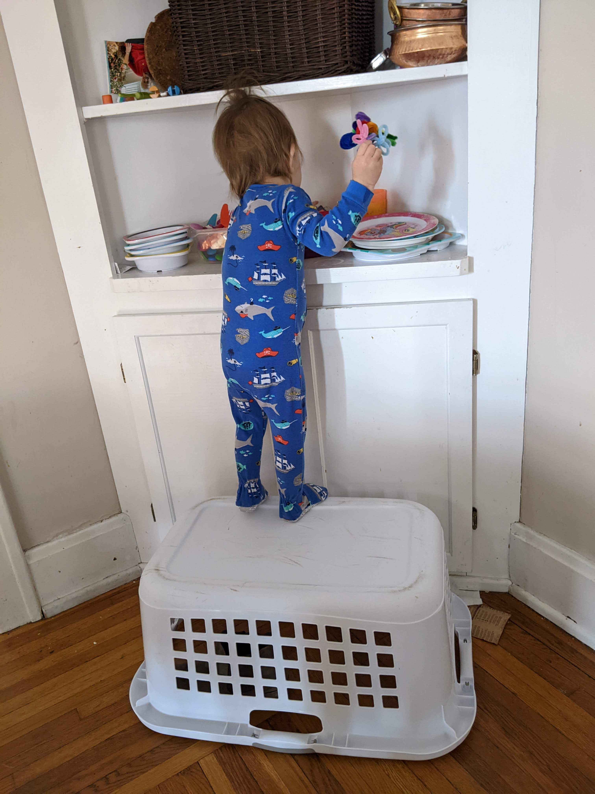
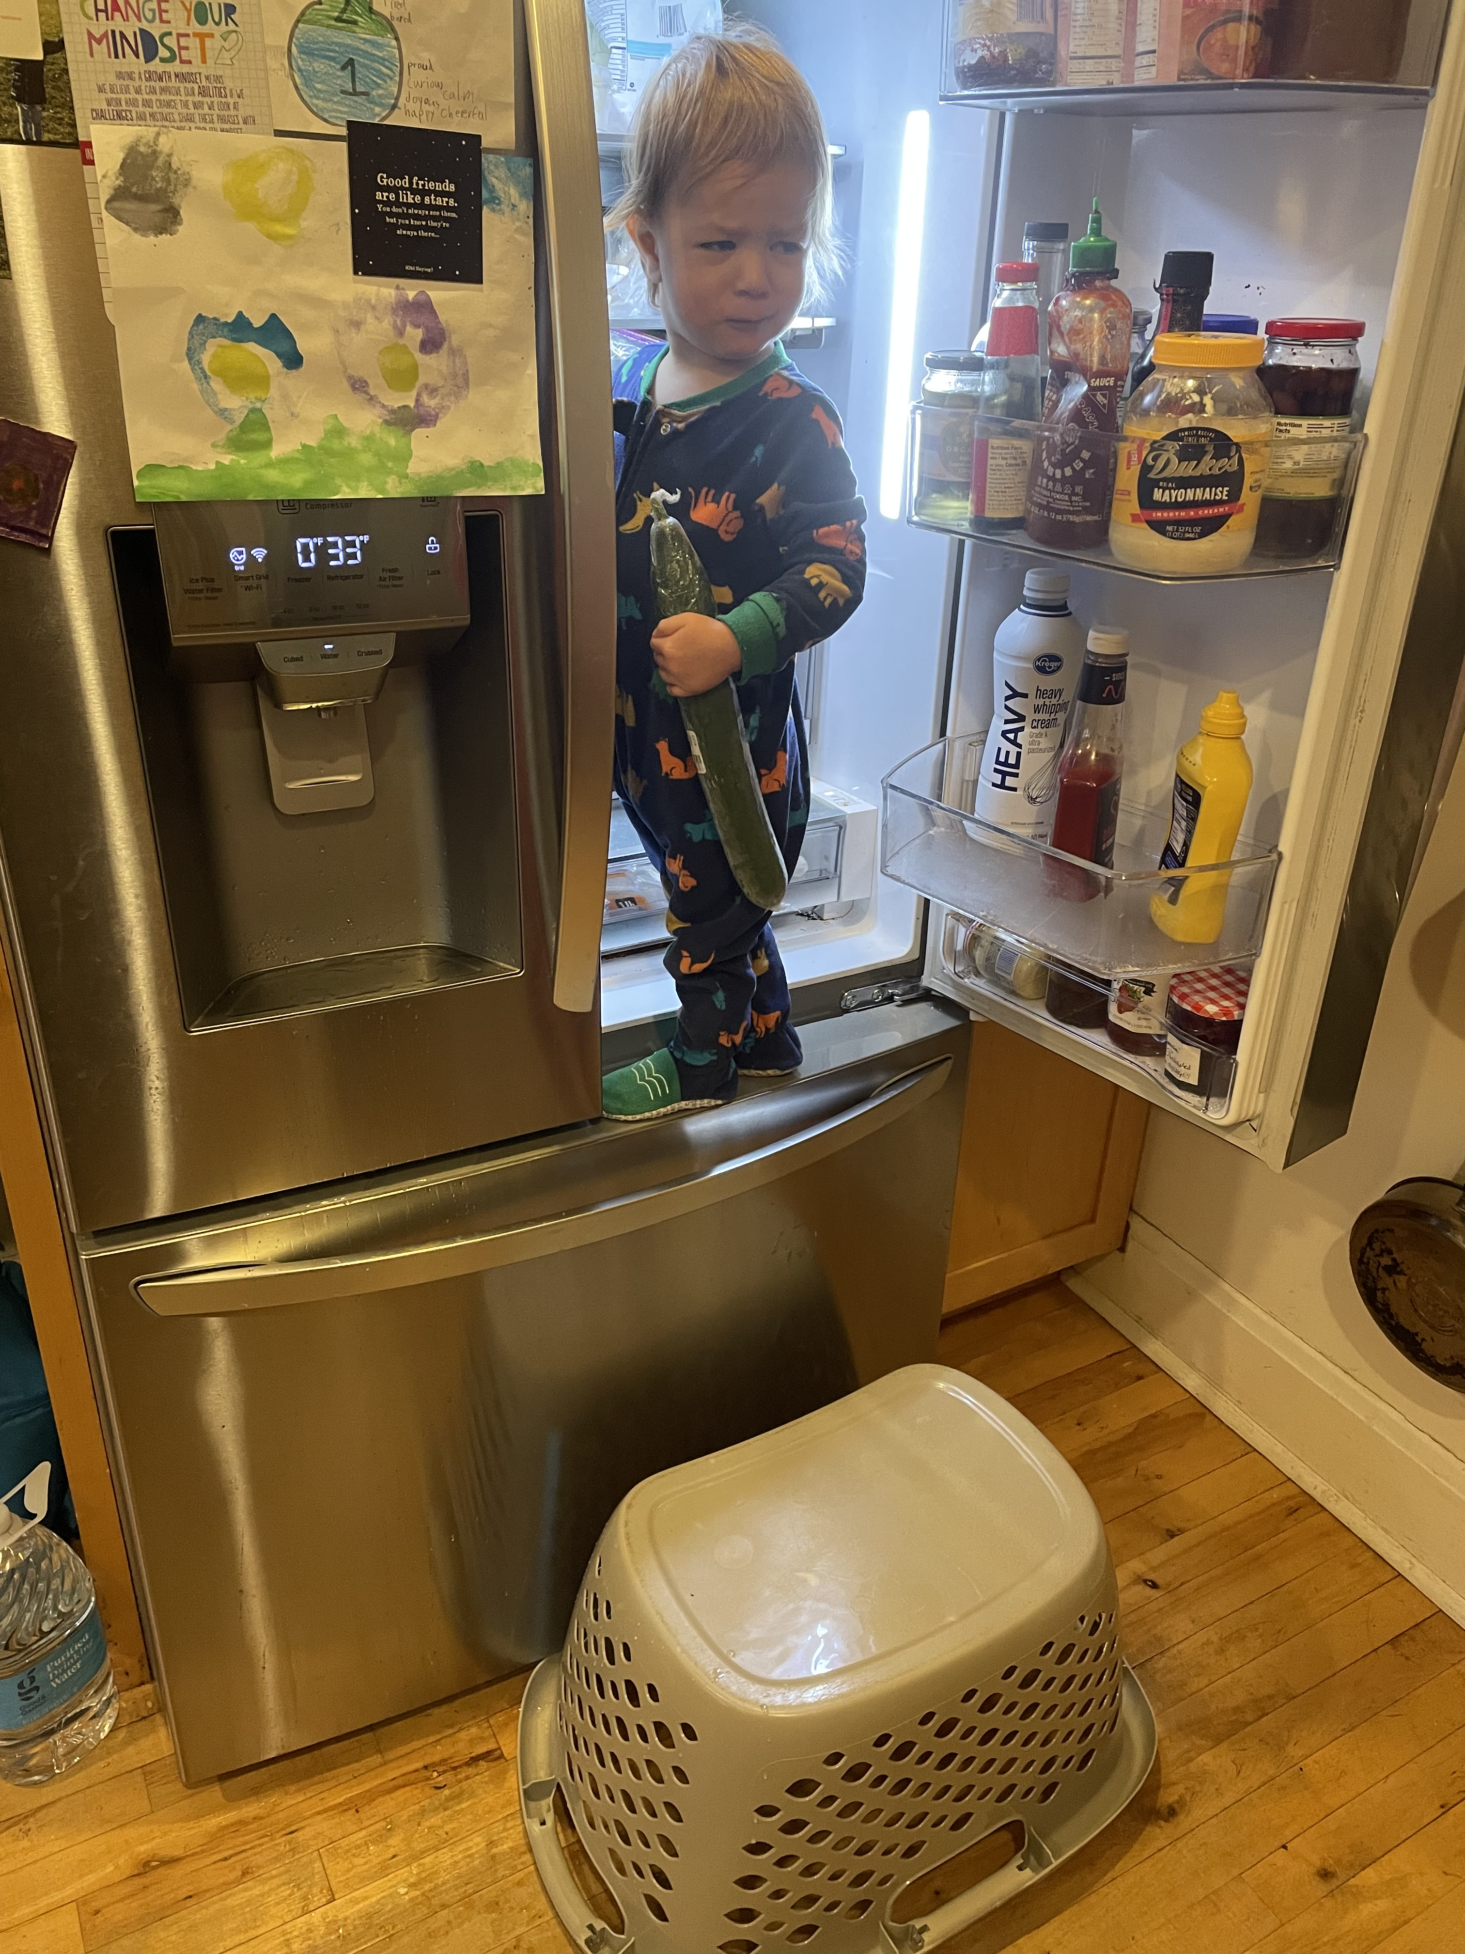
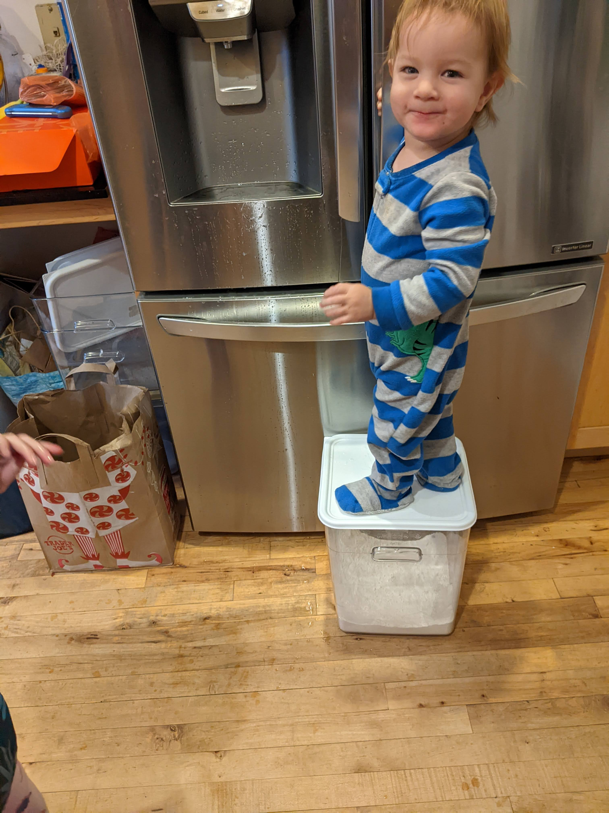
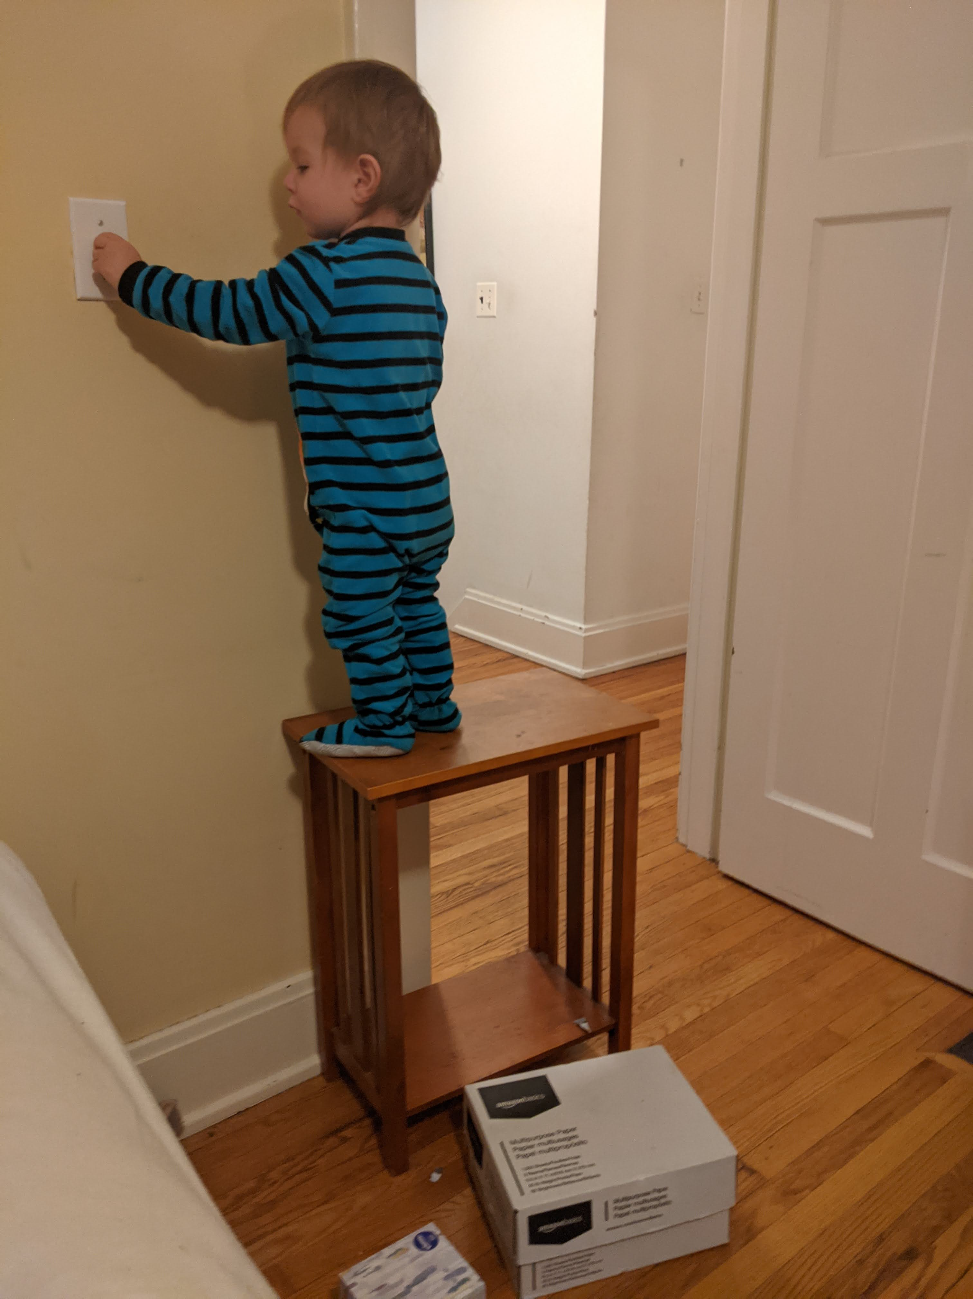
My kids…. Learning the physical world

Slide 26
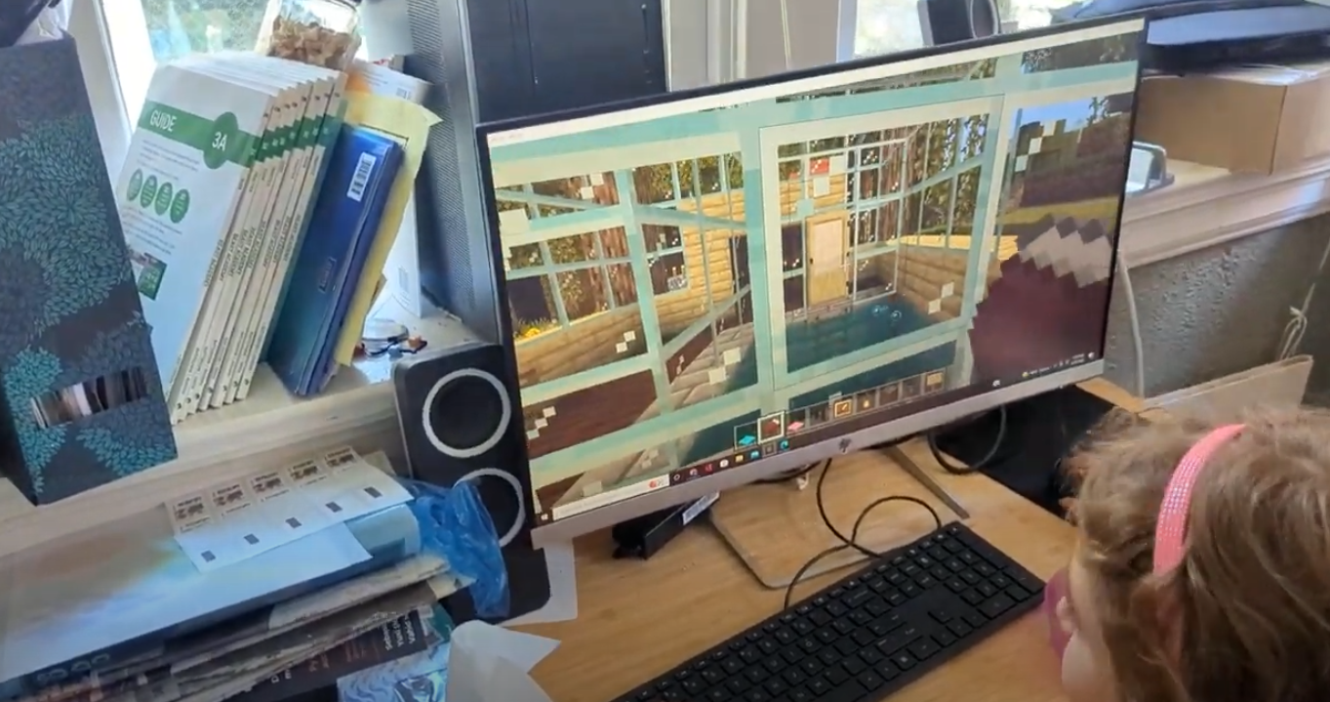
My kids… Learning about digital things

Slide 27
Learned, but also fundamental to the object
So, yes these are learned
But, also they have much to do with the actual properties of how something works

Slide 28
Take-away
Use interface elements, or physical elements for devices in ways that match the affordance of the interface element
Consider the affordances!
Let’s quick think about the affordances of….

Slide 29
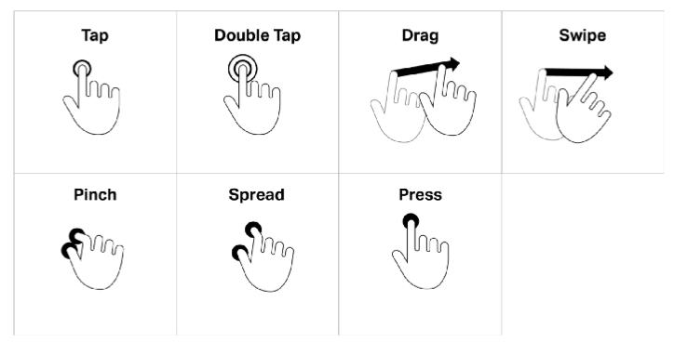
Sometimes you need help to learn an affordance
Touch screen interactions we have learned- this touch screen can be …. (Tapped on, double tapped on, dragged, swiped, pinched….)
Become universal affordances across devices and platforms
But in the early days of touch interaction, we hadn’t learned them
Needed help

Slide 30
Sometimes you need a signifier
But, what if the affordance of an interfaces is not immediately perceived by the user?
Where do I touch to interact?
Or, what if the current state or significance of the element needs to be highlighted?
Need a signifier

Slide 31
Where do I click? Where can I touch?

Slide 32
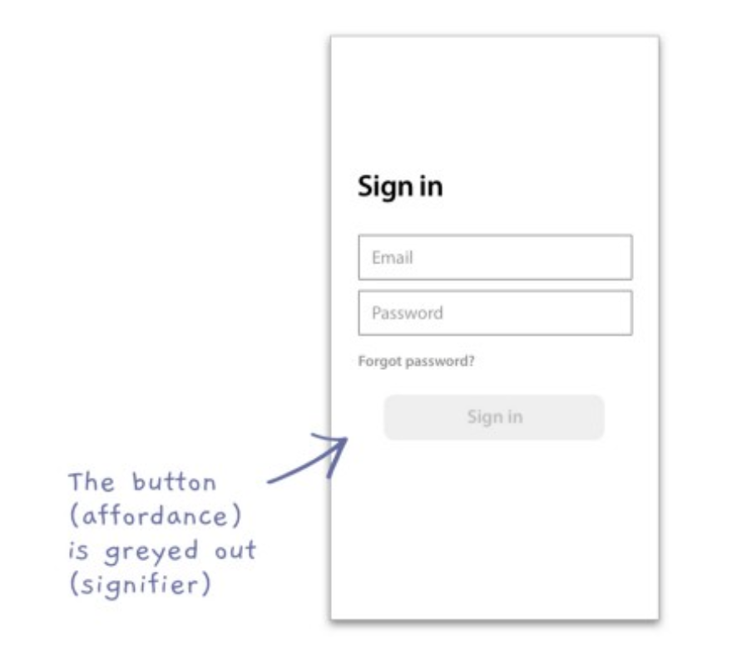
Signifiers
https://medium.com/@h_locke/affordances-and-signifiers-82bd6f50fc1a

Slide 33
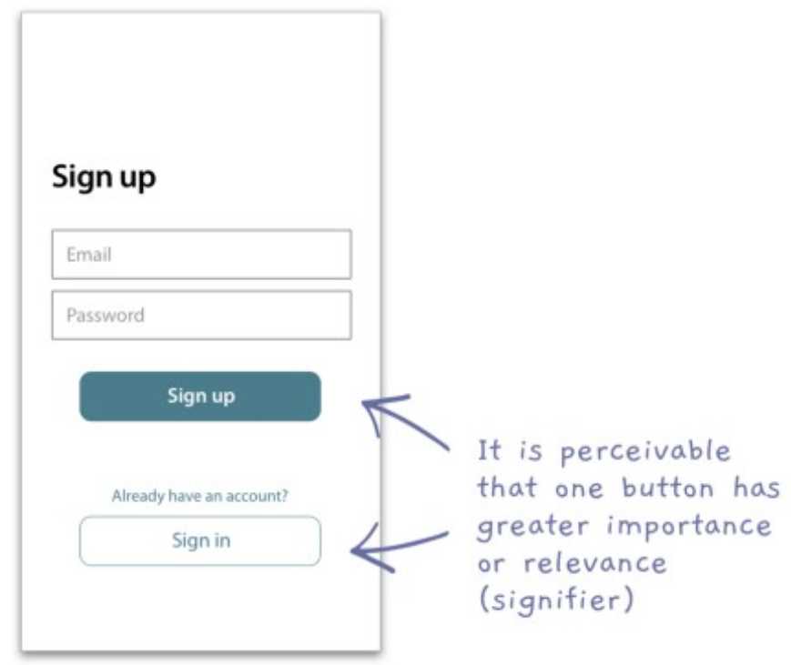
Signifiers

Slide 34
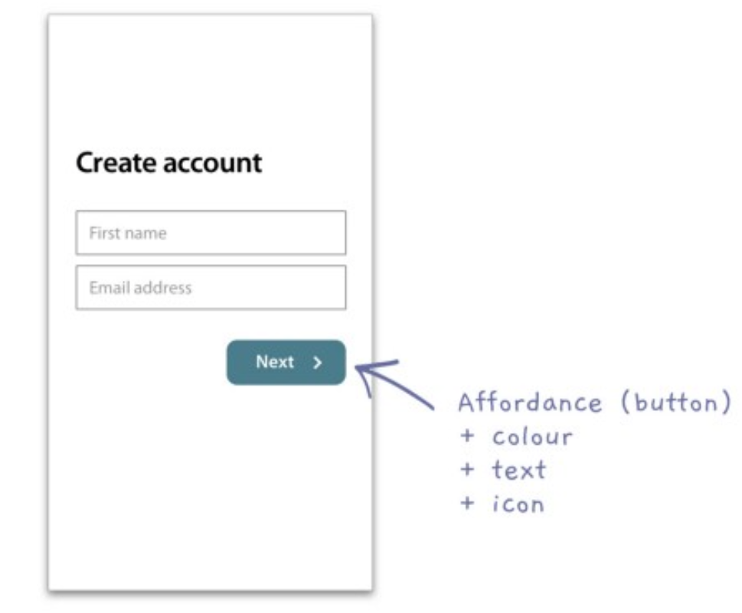
You can use layers of signifiers to increase clarity
Button
Affordance of being clickable
Has a color signifier which highlights that is active
It has a word signifier which describes the action
And a forward arrow, indicating the direction this action will take you in through the interface

Slide 35
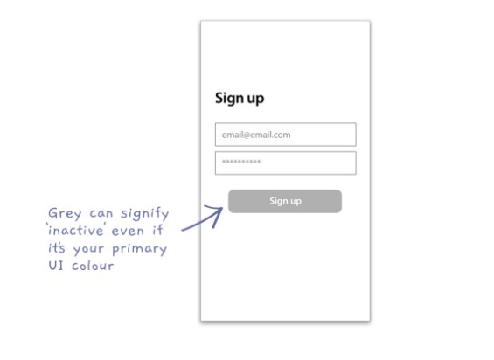
Ways you can confuse your user by mis-using signifiers and affordances

Slide 36
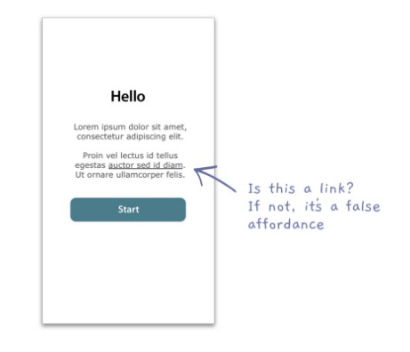
Ways you can confuse your user by mis-using signifiers and affordances

Slide 37
Constraints
Affordances
Signifiers
Constraints
Mappings
Feedback
User’s conceptual model of the system

Slide 38
What are constraints
Constraints are about limiting the range of interaction possibilities for the user, to
Simplify the interface
Guide the user to the appropriate next action

Slide 40
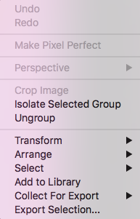

Slide 41
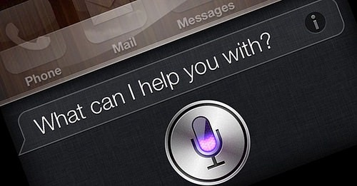
Constraint challenges
Conversational interaction or natural interaction
Hard to convey to someone what are the constraints
We feel unconstrained in how we interact through conversational interactions

Slide 42
Affordances
Signifiers
Constraints
Mappings
Feedback
User’s conceptual model of the system

Slide 43
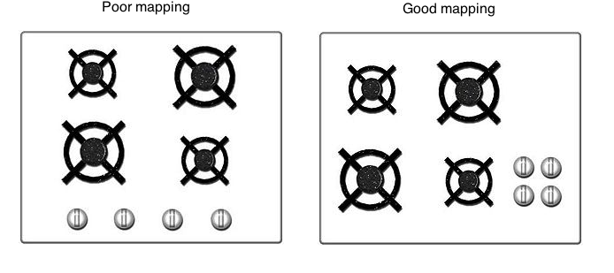
Mappings
How to communicate what an action will do
Considering the mapping – or relationship- from the controls and the impact real world

Slide 45
Other examples
Placement of light switches and the actual lights in the room
No need for a sign, if you spatially map it to the room

Slide 46
Spatial positioning to convey

Slide 47
Affordances
Signifiers
Constraints
Mappings
Feedback
User’s conceptual model of the system

Slide 48
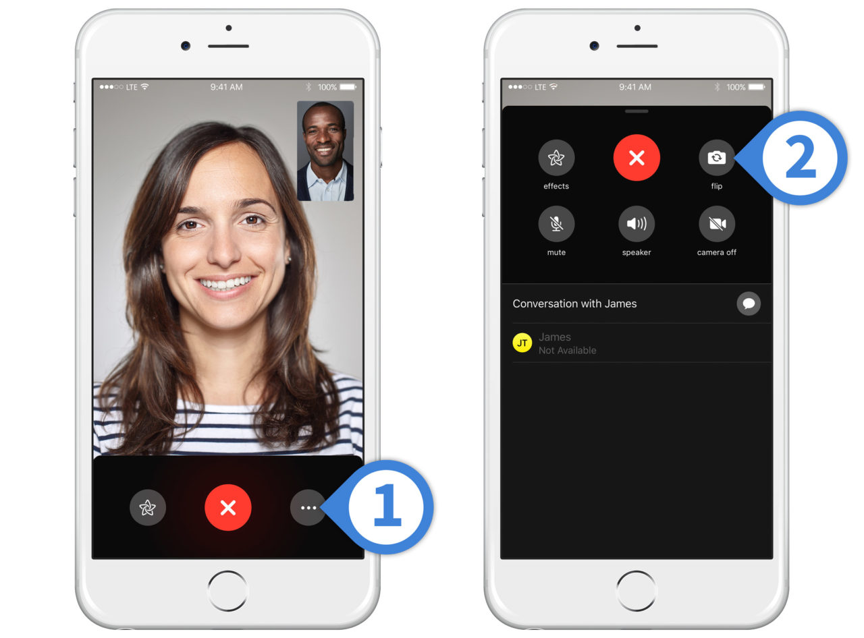
What is feedback?
Response- often visual, sometimes auditory- we get from performing an action
Serves as a confirmation that the action was performed
Anyone have examples of interfaces or controls with insufficient feedback
Did this work?
Did I press it?
Should I press it again?

Slide 49
Return to our learnabiity of a book
When I turn the page, I get lots of visual feedback that I have succeeded in accessing new content

Slide 50
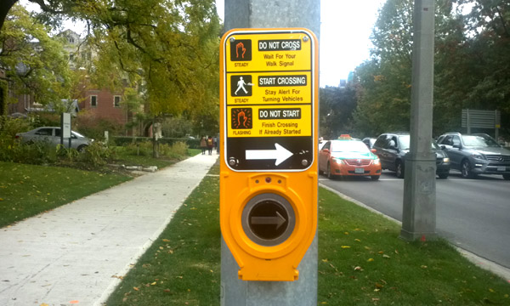
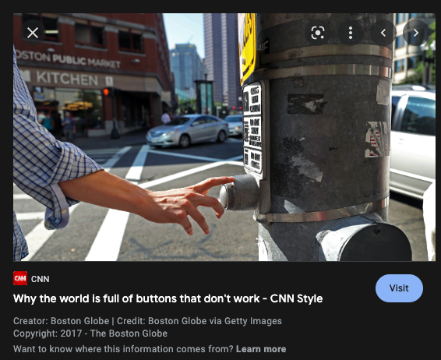
Some situations with lack of feedback
Pushing the up button in an elevator over and over
Pushing the walk button at a traffic stop over and over
Sitting at the light in your car- did it detect that I am here? Will it change?

Slide 51
Feedback- needs to be fast!
Studies- even 1/10 of a second can feel too slow
If people don’t get feedback, they’ll give up

Slide 52
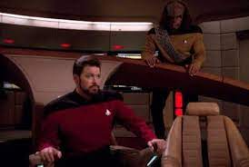
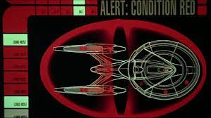
Feedback needs to be informative and not distracting
Indicator lights or sounds are good but
Don’t convey much
Distracting

Slide 53
Too much feedback -> people will ignore
Especially important in mission critical situations
Don’t want constant beeps and boops and flashing lights

Slide 54
Next time…..
User’s conceptual model of the system
And how to understand what user’s want to do with your interface- their goals

Slide 55
For our first project, we are going to design an interface to an appliance
“Interface of a smart <insert device>”
Redesign the interface to a <insert device>

Slide 56
For our first project, we are going to design an interface to an appliance
“Interface of a smart <insert device>”
Redesign the interface to a <insert device>
I would like to brainstorm with you some possible devices we could choose
Refrigerator door interface “Smart fridge”
Redesign a car interface
Design an UI for a shopping cart
Think about it…..

